Slide 1


Data Logging Using BMP 180 sensor and Esp8266 on Thing Speak
Course: Iot & ml
Class: Third Year
Program: B.Tech (ECE)
Team Member 1 Name: Ali Shan Ahmed PRN : 2114110429 ROLL NO: 01
Team Member 2 Name: Nur Mohammed Ali PRN : 2114110430 ROLL NO: 02
Team Member 3 Name: MD Gafrujama Ansari PRN : 2214110431 ROLL NO: 03

Slide 2
Project Statement
Components
Outcome And Output
Application
CO And References
Content

Slide 3
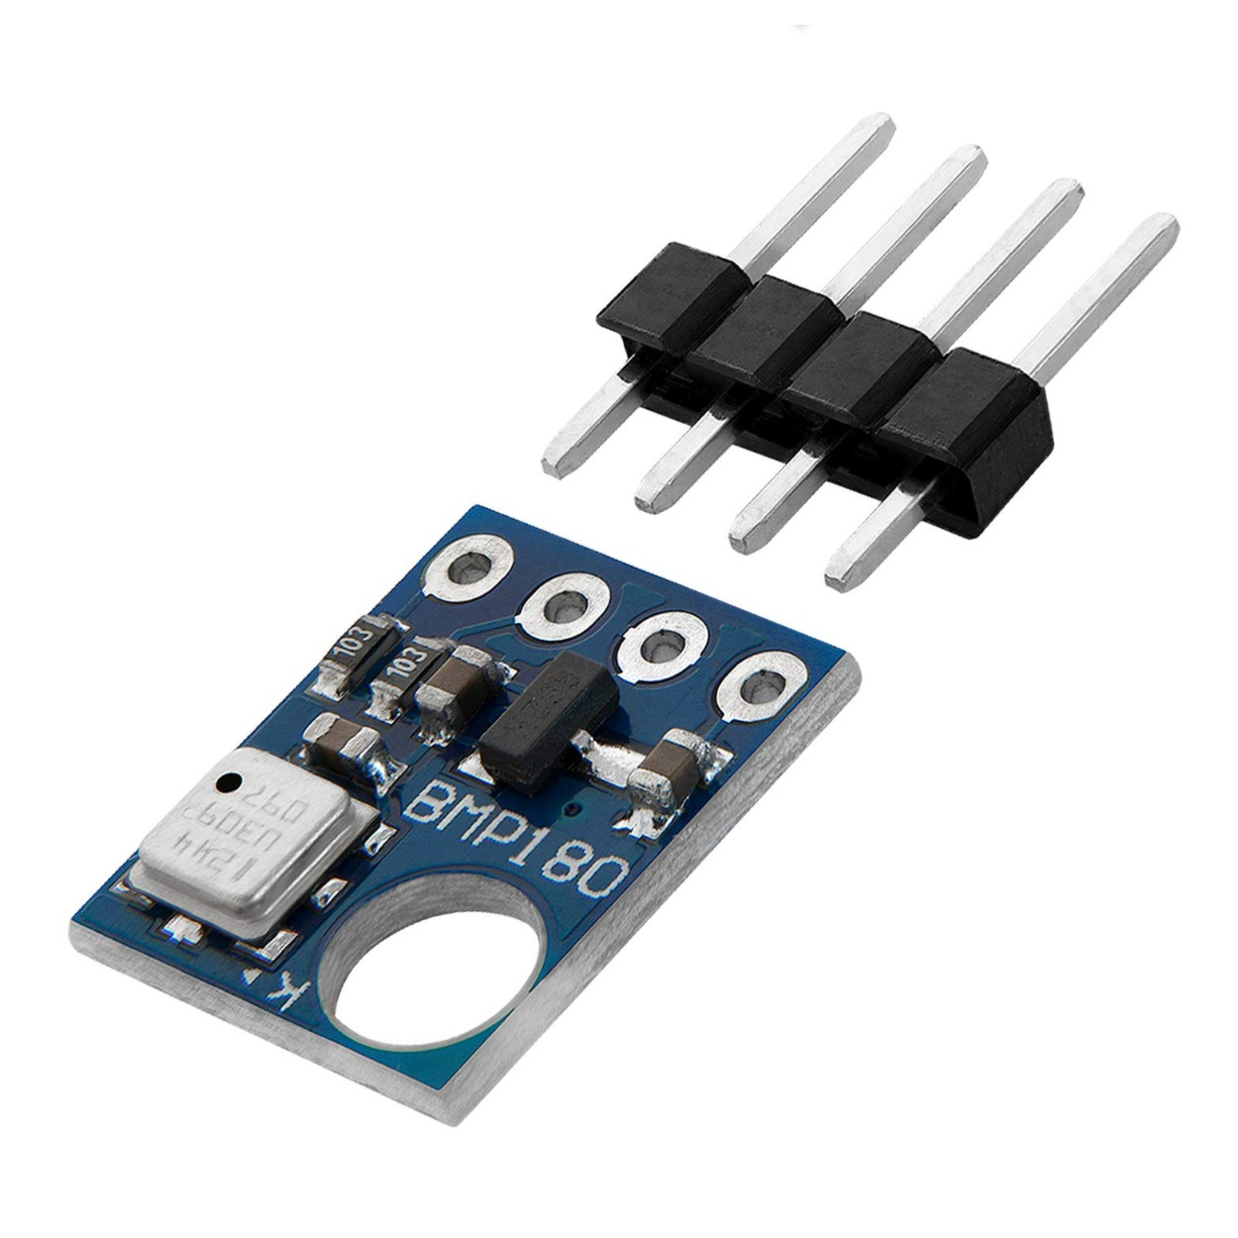
Project
Flow Chart
we aim to implement a system for data logging using the BMP180 sensor and ESP8266 microcontroller, with data visualization on Thing Speak, an Internet of Things (IoT) platform. The BMP180 sensor is utilized to measure environmental parameters such as temperature, pressure, and altitude, while the ESP8266 serves as the microcontroller for data acquisition and transmission

Slide 4
Component
Node MCU ESP8266
BMP 180 Sensor
The NodeMCU, based on the ESP8266 Wi-Fi module, served as the master microcontroller platform, enabling Wi-Fi connectivity and efficient data transfer between the Arduino Uno and other devices.
BMP180 is one of sensor of BMP XXX series. They are all designed to measure Barometric Pressure or Atmospheric pressure. BMP180 is a high precision sensor designed for consumer applications. Barometric Pressure is nothing but weight of air applied on everything. The air has weight and wherever there is air its pressure is felt. BMP180 sensor senses that pressure and provides that information in digital output. Also the temperature affects the pressure and so we need temperature compensated pressure reading. To compensate, the BM180 also has good temperature sensor.

Slide 5
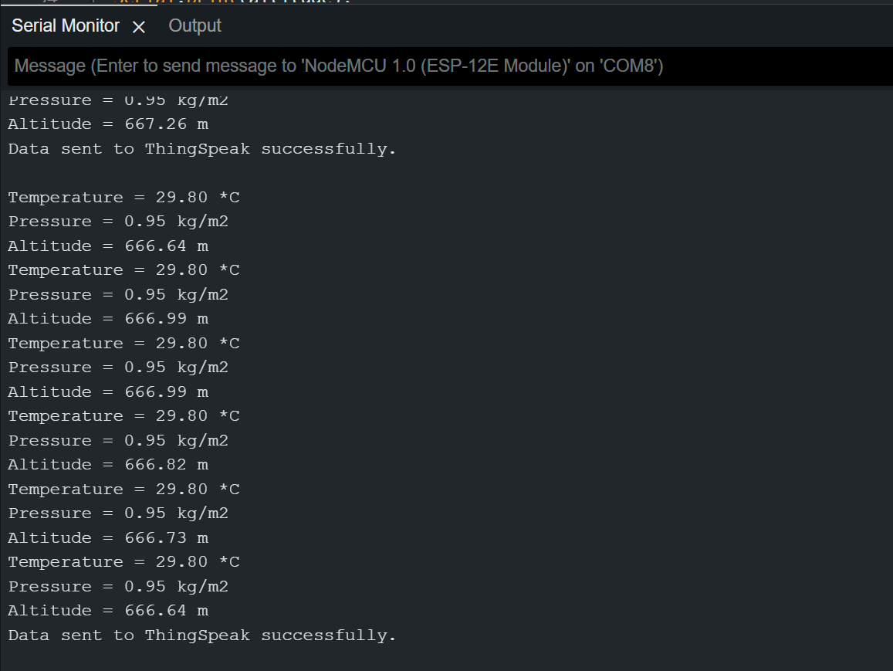
Outcome And Output
Read sensor data including temperature, pressure, and altitude from the BMP180 sensor.
Convert pressure from Pascal to kg/cm².
Print the sensor data (temperature, pressure in kg/cm², and altitude) to the serial monitor.
Begin communication with ThingSpeak using the WiFi client.
Set the field values for temperature, pressure, and altitude.
Write the data to the ThingSpeak channel.
Check the response from ThingSpeak. If successful (HTTP response code 200), print a success message; otherwise, print an error message.
Delay for a specified interval before logging the next

Slide 6
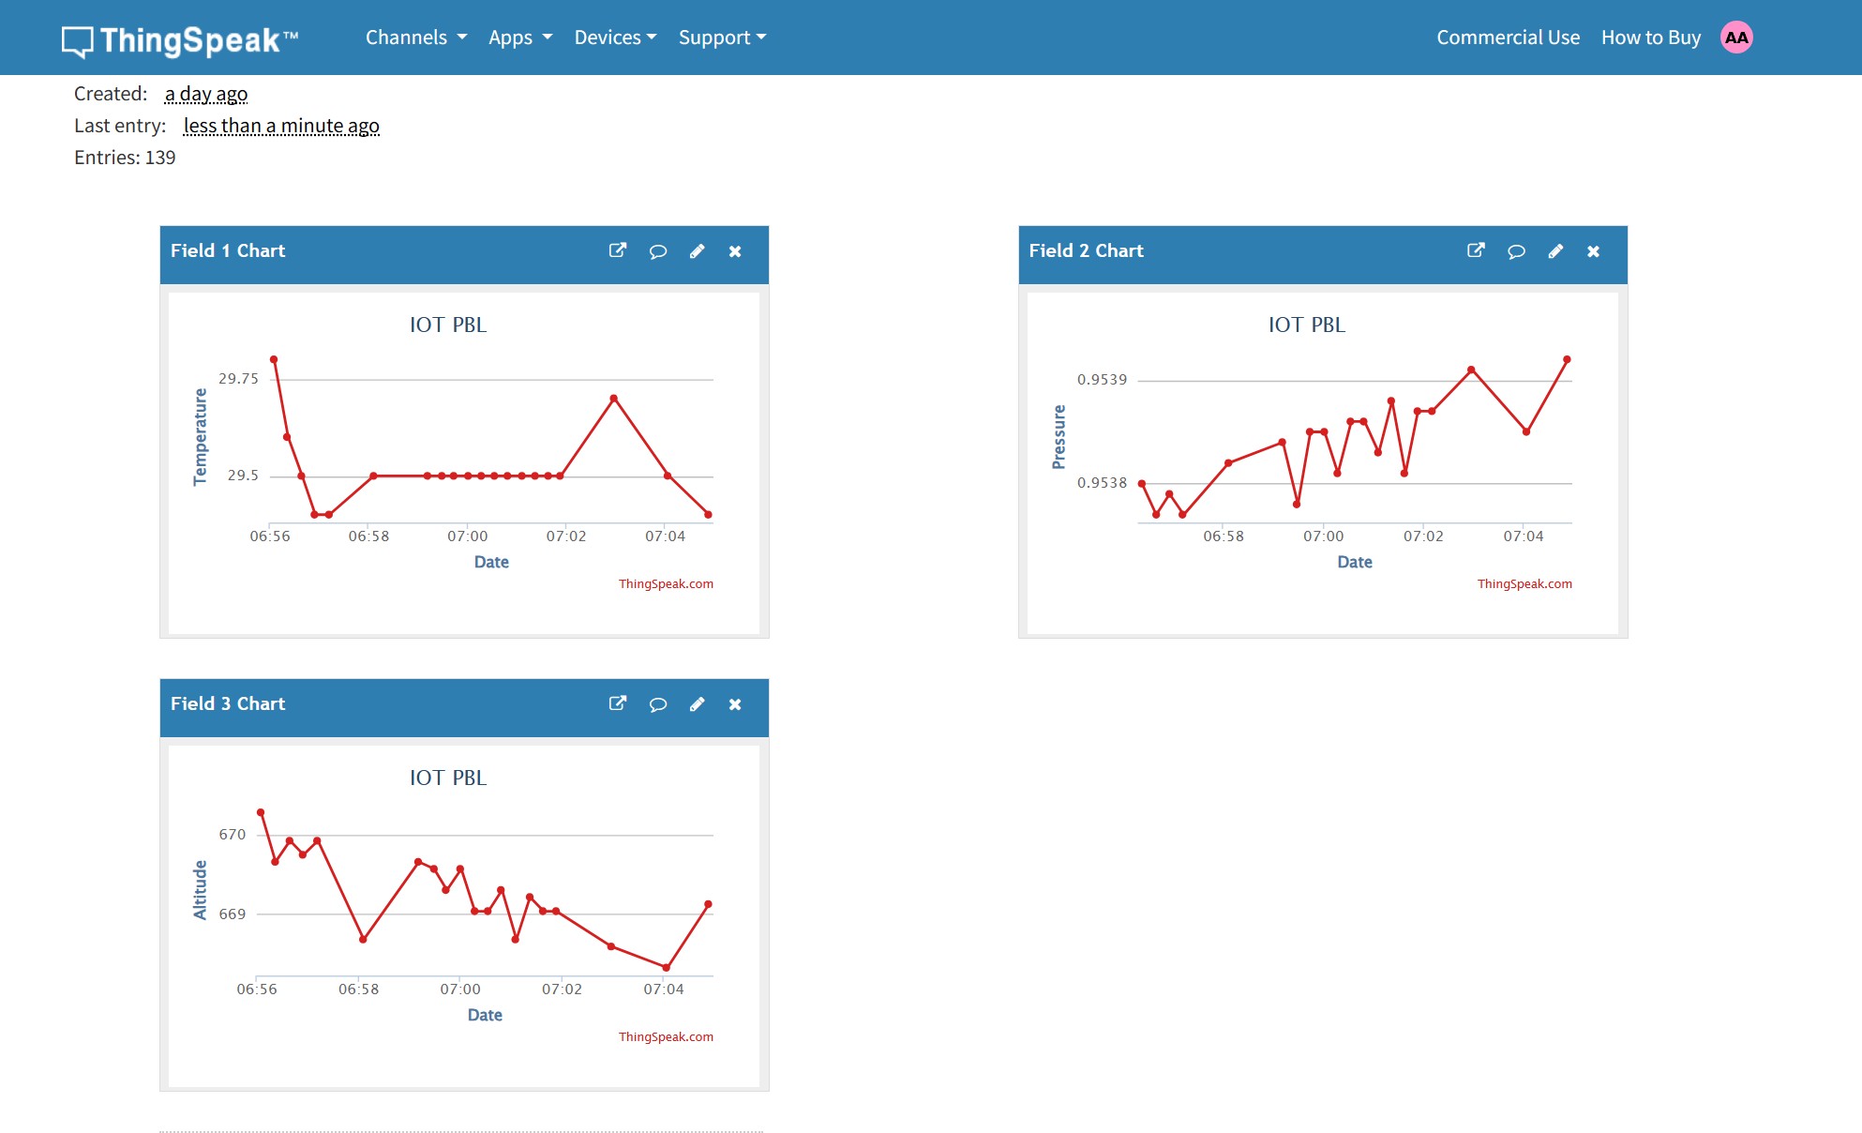
Thingspeak Graph

Slide 7
Applications
Weather Monitoring and Forecasting:
Altitude Measurement in Aviation:
Indoor and Outdoor Navigation:
Environmental Monitoring and Agriculture:

Slide 8
THANK YOU

